Slide 1
Bus Spy: Récupération d’informations d’un SoC FPGA par le biais des émanations électromagnétiques du bus AXI interne
PhD: May Myat Thu (IETR)
Thesis Director: Philippe Besnier (IETR)
Co-director: Maxime Pelcat (IETR)
Co-supervisor: Maria Méndez Real (IETR)
Projet : VAVIECA, DGA funding through CREACH LABS
13-14-15 Juin 2023
CEM

Slide 2
Summary
I. Introduction / Motivation
II. Related work
III. Hardware Platform and NN implementation
IV. Methodology & Evaluation
V. Conclusions

Slide 3
I. Introduction
Embedded Artifical Intelligence
Side Channels and Hardware Security

Slide 4
Embedded Artificial Intelligence
Widely used nowadays
Easy access to public
Processing sensitive data

Slide 5
Side-channels and Hardware Security
Security exploit that attempts to extract secrets from a chip or a system
Achieved by measuring or analyzing various physical parameters
Device under attack (DUA)

Slide 6
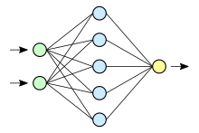
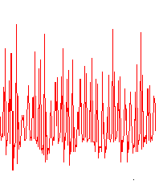
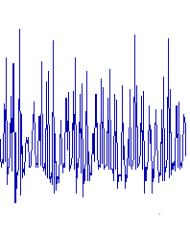
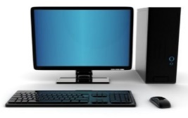
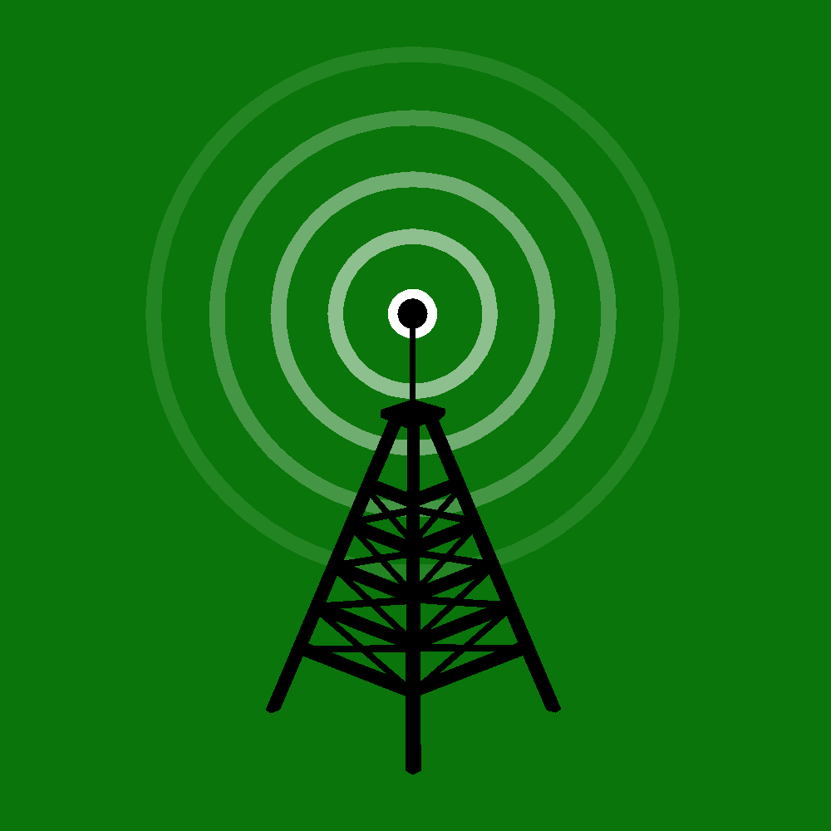
Motivation of this work
Objective
Analyze the unintended electromagetic traces from hardware accelerators
Exploit input data to neural network (NN) implemented on accelerator
Hardware: FPGA
Traces
Analysis
Leakage of information
Input data
Neural network architecture
Network parameters
Méndez Real, M.; Salvador, R. Physical Side-Channel Attacks on Embedded Neural Networks: A Survey. Appl. Sci. 2021

Slide 7
II. Related Work
TEMPEST Attacks
Attacks on Cryptographic Algorithm
Attacks on NN accelerators

Slide 8
TEMPEST Attacks
Van Eck phreaking attack, which is also known as a Transient Electromagnetic Pulse Emanation Standard (TEMPEST)
Monitors the EMF (electromagnetic field) radiation emitted by a computer screen
Extracts information on the targeted screen before it is encrypted
Wim van Eck. Electromagnetic radiation from video display units: An eavesdropping risk? Computers and Security, 1985
Markus Kuhn. Electromagnetic eavesdropping risks of flat-panel displays. LNCS, 2004

Slide 9
Attacks on Crypto Algorithms
Das, Debayan & Nath, Mayukh & Chatterjee, Baibhab & Ghosh, Santosh & Sen, Shreyas. (2019). STELLAR: A Generic EM Side-Channel Attack Protection through Ground-Up Root-cause Analysis.

Slide 10
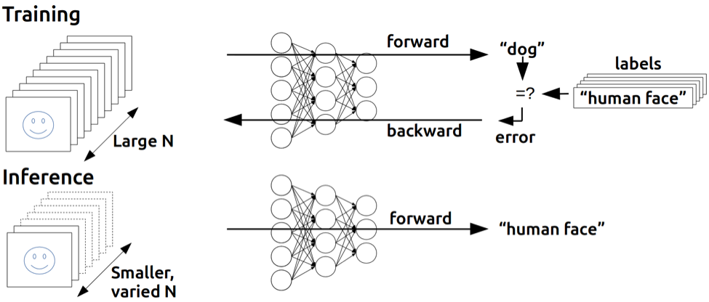
Attacks on Neural Networks
Possible Leakage of DNNs
Input Image
Architecture (layers, neurons, etc)
Parameters (weight, activation function, etc)
https://developer.nvidia.com/blog/inference-next-step-gpu-accelerated-deep-learning/

Slide 11
III. Hardware Platform and NN implementation

Slide 12
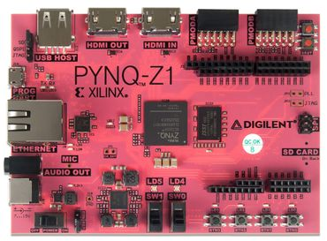
Hardware Platform (System-on-chip FPGA)
Integrates processor and programmable logic onto a single chip
- Power efficient
- High speed performance, less latency
- Customizabale
PYNQ Z1
- Features Zynq®-7020 SoC, which has Xilinx Artix 7 FPGA fabric + dual-core ARM Cortex™-A9 processor
- Also uses open-source framework which onboard SoC can be easily programmed with Python
- One of the main devices supported by the FINN compiler
Shafiq, Farhan & Yamada, Takato & Vilchez, Antonio & Dasgupta, Sakyasingha. (2017). Automated flow for compressing convolution neural networks for efficient edge-computation with FPGA.

Slide 13
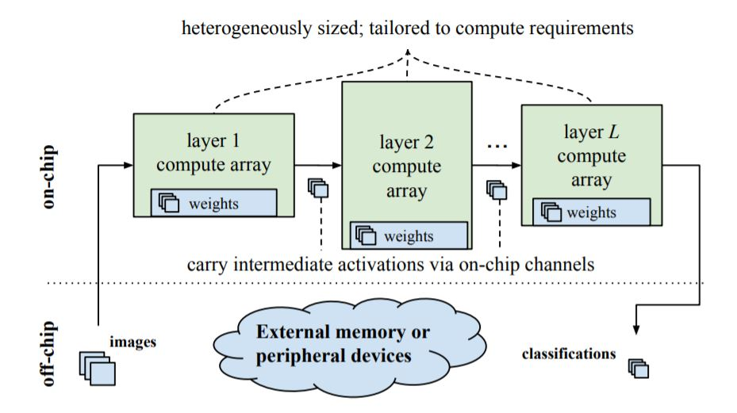
Neural Network Implementation
FINN Framework
- Open source framework by Xilinx
- Generation of quantized NN inference accelerators to be run on FPGAs
- Apply time-multiplexing through folding to match the network layers to available hardware computational units
- Supports the mapping of traditional neural networks and various topologies
Why FINN ?
Quantization of weights
Less memory print
Lower energy consumption
Brevitas: https://github.com/Xilinx/brevitas
Finn: https://github.com/Xilinx/finn
Michaela Blott, Thomas B. Preußer, Nicholas J. Fraser, Giulio Gambardella, Kenneth O’brien, Yaman Umuroglu, Miriam Leeser, and Kees Vissers. 2018. FINN-R: An End-to-End Deep-Learning Framework for Fast Exploration of Quantized Neural Networks. ACM Trans. Reconfigurable Technol. Syst. 11

Slide 14
Neural Network Implementation
6 @ 28 x 28
6 @ 14 x 14
16 @ 10 x 10
16 @ 5 x 5
120
84
28 x 28
Name | Input Quantization | Weight Quantization | Activation Quantization | Dataset | Accuracy
TFC_1W1A | 1 bit | 1 bit | 1 bit | MNIST | 93,17%
Tra, Viet & Kim, Jaeyoung & Khan, Sheraz & Kim, Jongmyon. (2017). Bearing Fault Diagnosis under Variable Speed Using Convolutional Neural Networks and the Stochastic Diagonal Levenberg-Marquardt Algorithm Sensors 17

Slide 15
IV. Methodology & Evaluation
Hardware Setup
Electromagnetic Cartography
Overview of attack
Recovered Images from EM Side-channels

Slide 16
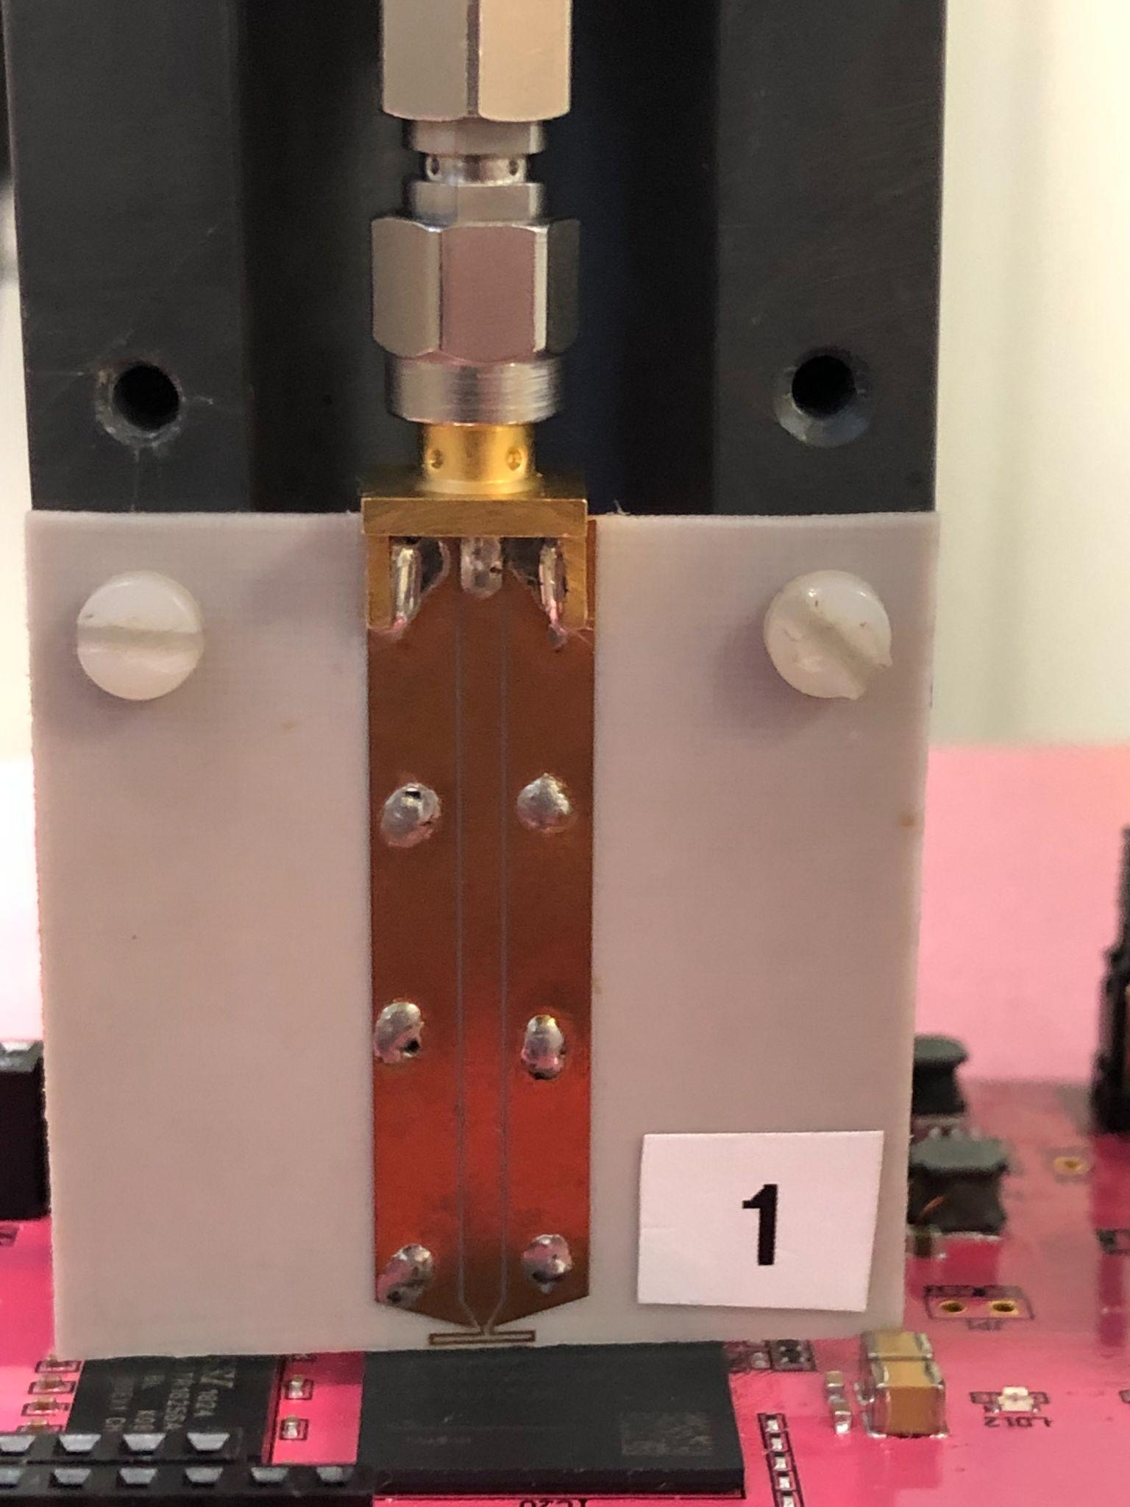
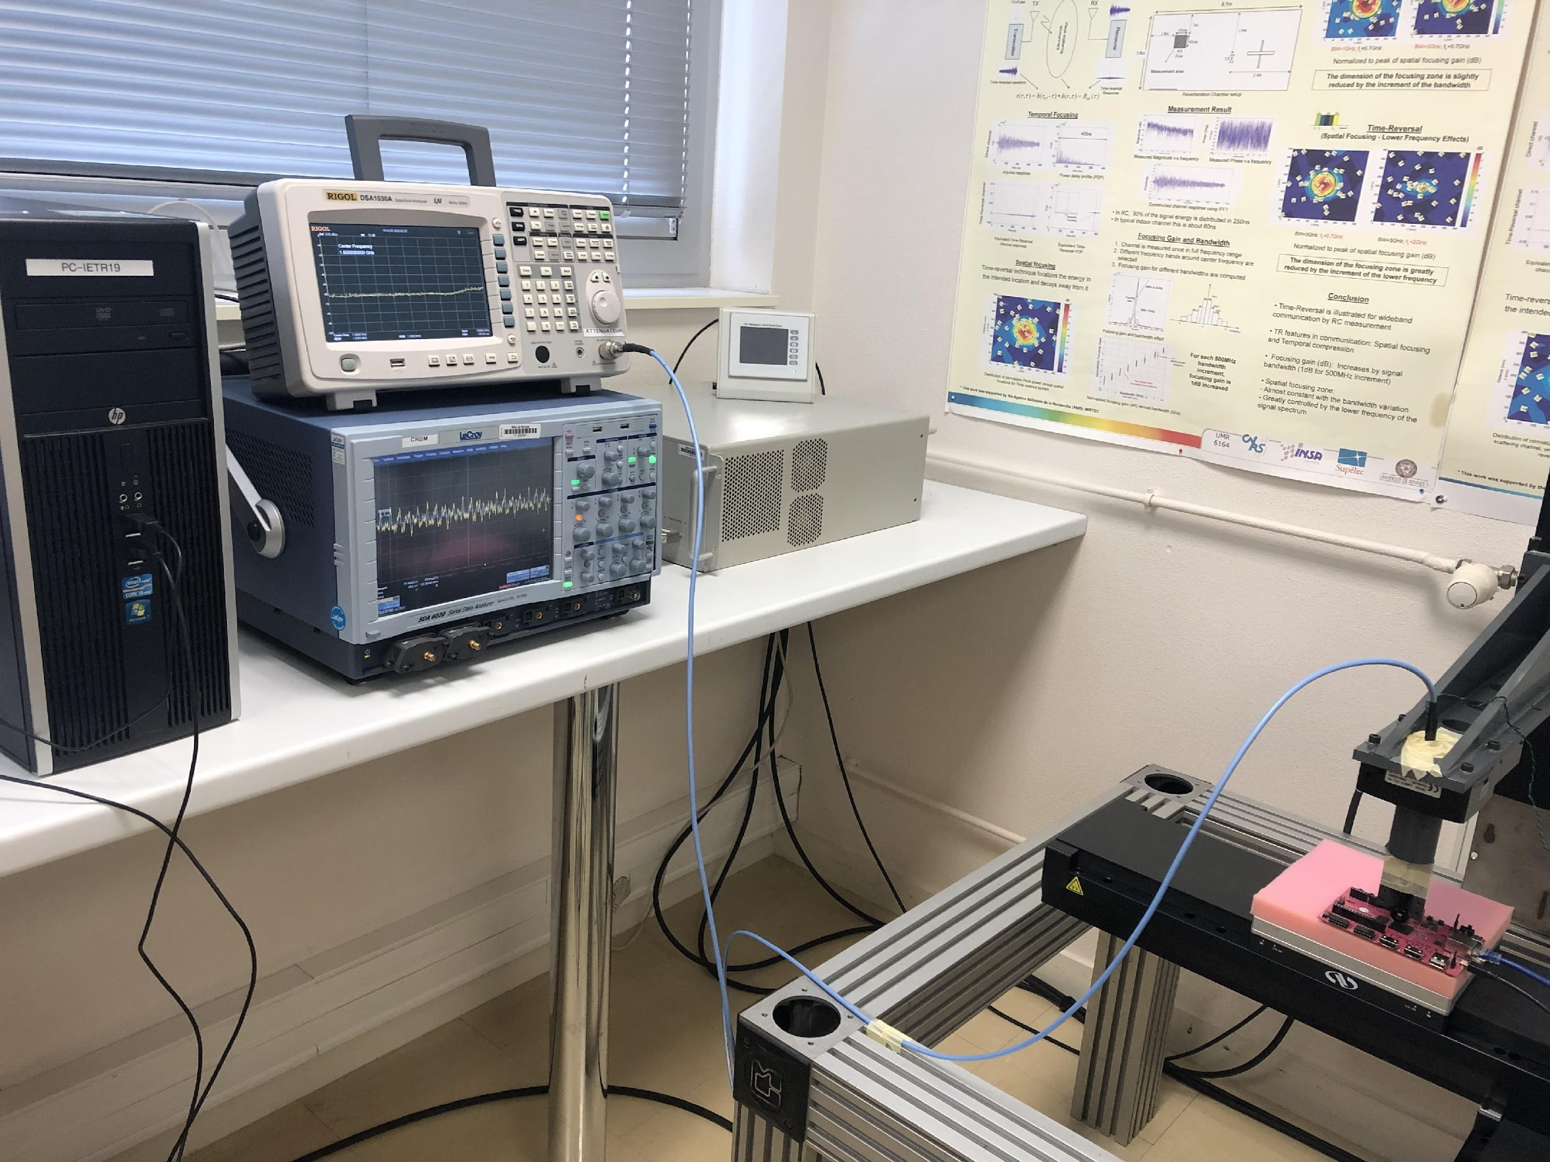
Hardware Setup
Equipments
PYNQ Z1 (with ZYNQ-7020)
Customized H-field probe
Positioner
Low Noise Amp 30dB
Oscilloscope
Spectrum Analyzer

Slide 17
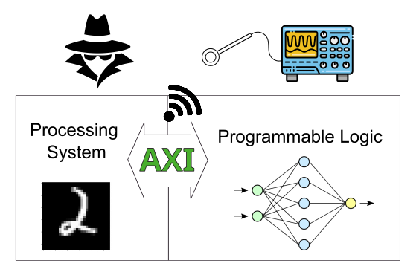
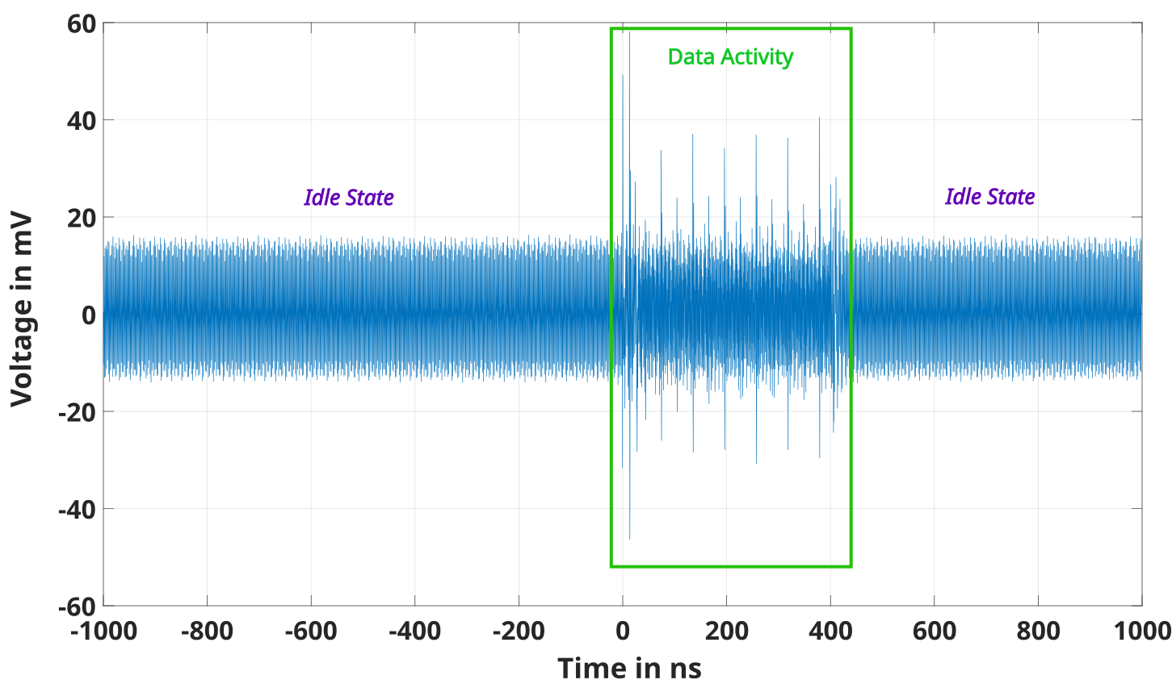
Electromagnetic Cartography
Hy
Cartography shows the point of interest (POI) where the highest leakage lies

Slide 18
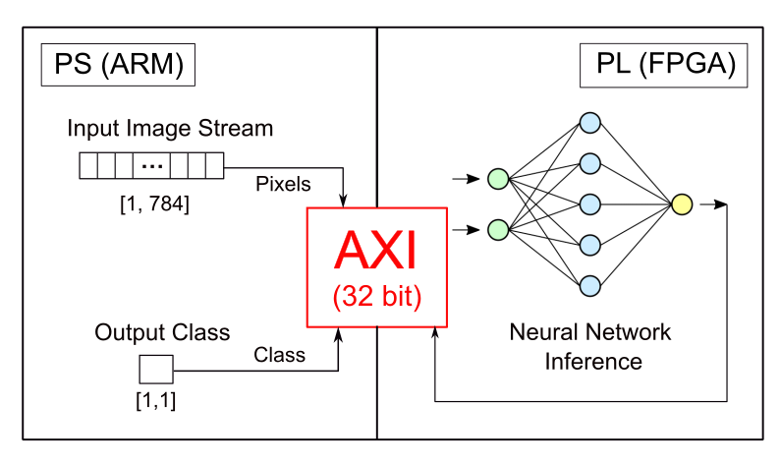
Location of Leakage

Slide 19
Overview of Attack

Slide 20
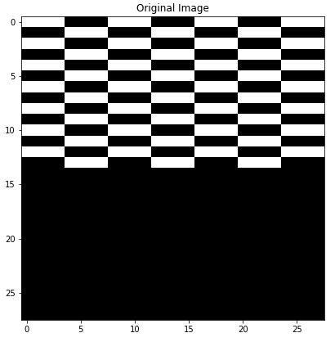
Calibration Images
First step to study the behavior of EM traces with respect to bits changes
Manipulate the input images and observe the outcome trace signals.
Calibration images: Black, White, B&W Lines and half Checker Print

Slide 21
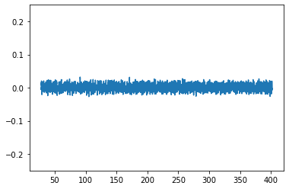
Calibration Images
Voltage in V
Time in ns
Voltage in V
Time in ns

Slide 22
Calibration Images
Voltage in V
Time in ns
Voltage in V
Time in ns

Slide 23
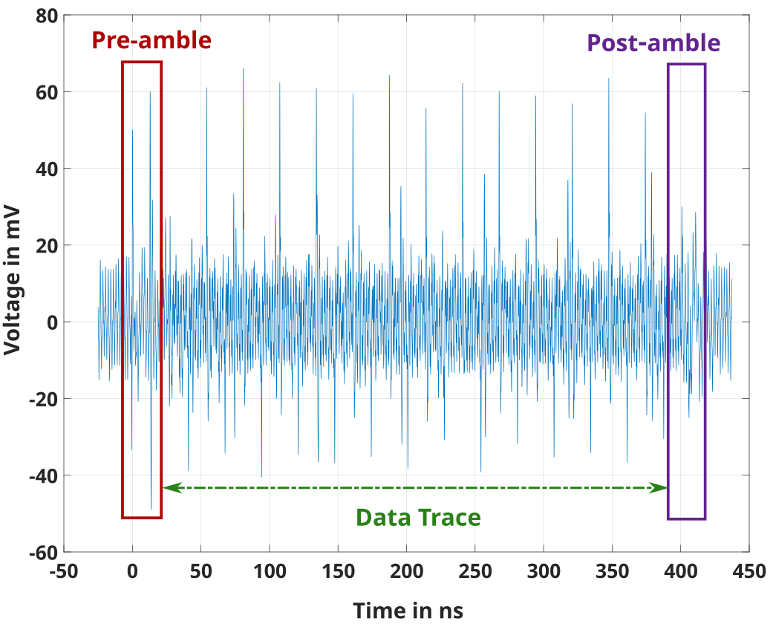
Signal Processing
Averaging (x 200) to remove noise
Possible thanks to data independant signals: pre-amble and post-amble which frames the data traces

Slide 24
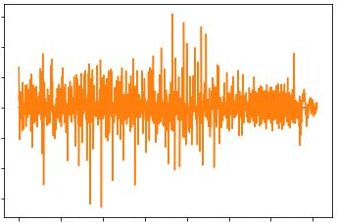
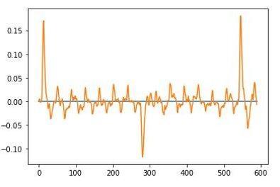
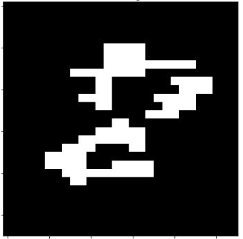
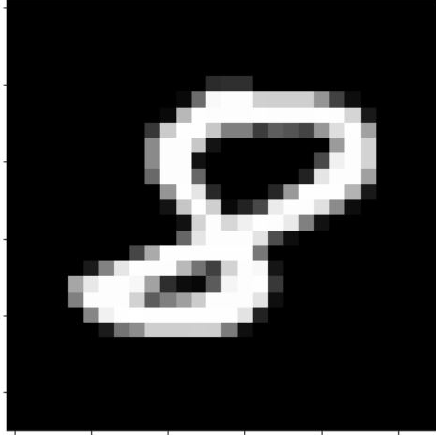
Peak Analysis
Input to NN
Peaks (positive or negative) represents transition of pixel values between two consecutive clock cycles.
If transition goes up, e.g, from 0 to 255, a positive peak will occur with the highest V value and vice versa
- Initiate an empty matrix with only zeros
- Defines a threshold.
- Detects positive edge => white pixel (255)
- Maintain white (255) value
- Detects negative edge => pixel goes black (0) value.
Recovered Image

Slide 25
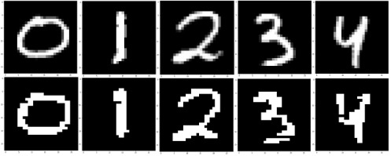
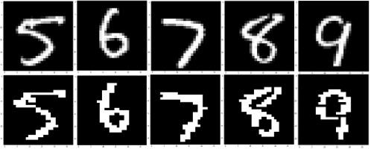
Recovered MNIST Images
Original Image
Recovered Image
Original Image
Recovered Image

Slide 26
V. Conclusion

Slide 27
Conclusion
a) AXI data buses on SoC-FPGAs are vulnerable to EM side-channel attacks
b) Experimented using popular BNN framework
c) Implementable on other application as long as there is hardwired on-chip bus
Publications
The extended version of this work has been accepted in;
«Bus Electrocardiogram:Vulnerability of SoC-FPGA Internal AXI Bus to Electromagnetic Side-Channel Analysis» in the International Symposium and Exhibition on Electromagnetic Compatibility (EMC Europe 2023 )
« You Only Get One-Shot: Eavesdropping Input Images to Neural Network by Spying SoC-FPGA Internal Bus » in the 18th International Conference on Availability, Reliability and Security (ARES 2023 )

